Slide 1


Filtering Resumes by Job Category using MULTI LABEL TEXT CLASSIFICATION AND Topic Modelling (NLP)
Capstone project - final presentation
ARPAN DAS
UTTARAN GANGOPADHYAY
CARLOS JOSE ZURITA CANO
BRIAN CHRISTIAN

Slide 2

EXTERNAL PROJECT COMPANY
JOBS FOR HUMANITY
Jobs for Humanity is a Human Resources company based in New York which paves the way to a fairer future for all by connecting historically underrepresented talent to welcoming employers which involves:
Refugees
Blind
Neurodivergent
Single Moms
Black Leaders
Returning Citizens

Slide 3

Agenda
To help improve the company’s job search algorithm by putting resumes into their respective categories. The current accuracy is around 75%.
Expand the “others” category in their job categories by filling it with newer job categories.
Extract expertise level from resume titles and descriptions.

Slide 4
work timeline
JAN | FEB | MAR | APR
Got a fair overview of the project and it’s objectives. | Acquired the dataset and performed preliminary EDA along with searching for methods to complete the project. | Experimented with different NLP techniques like NER and topic modelling using LDA and Spacy libraries. | Reviewed all the different methods and finalized the ones that are needed for the project and completed it.

Slide 5

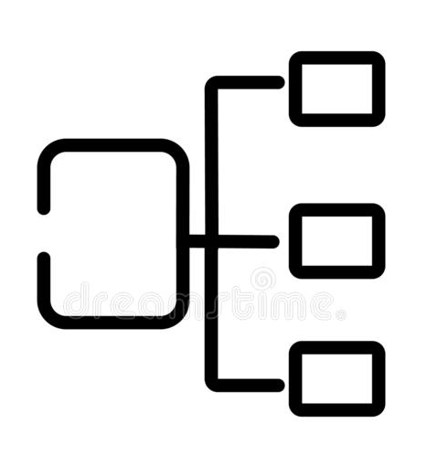


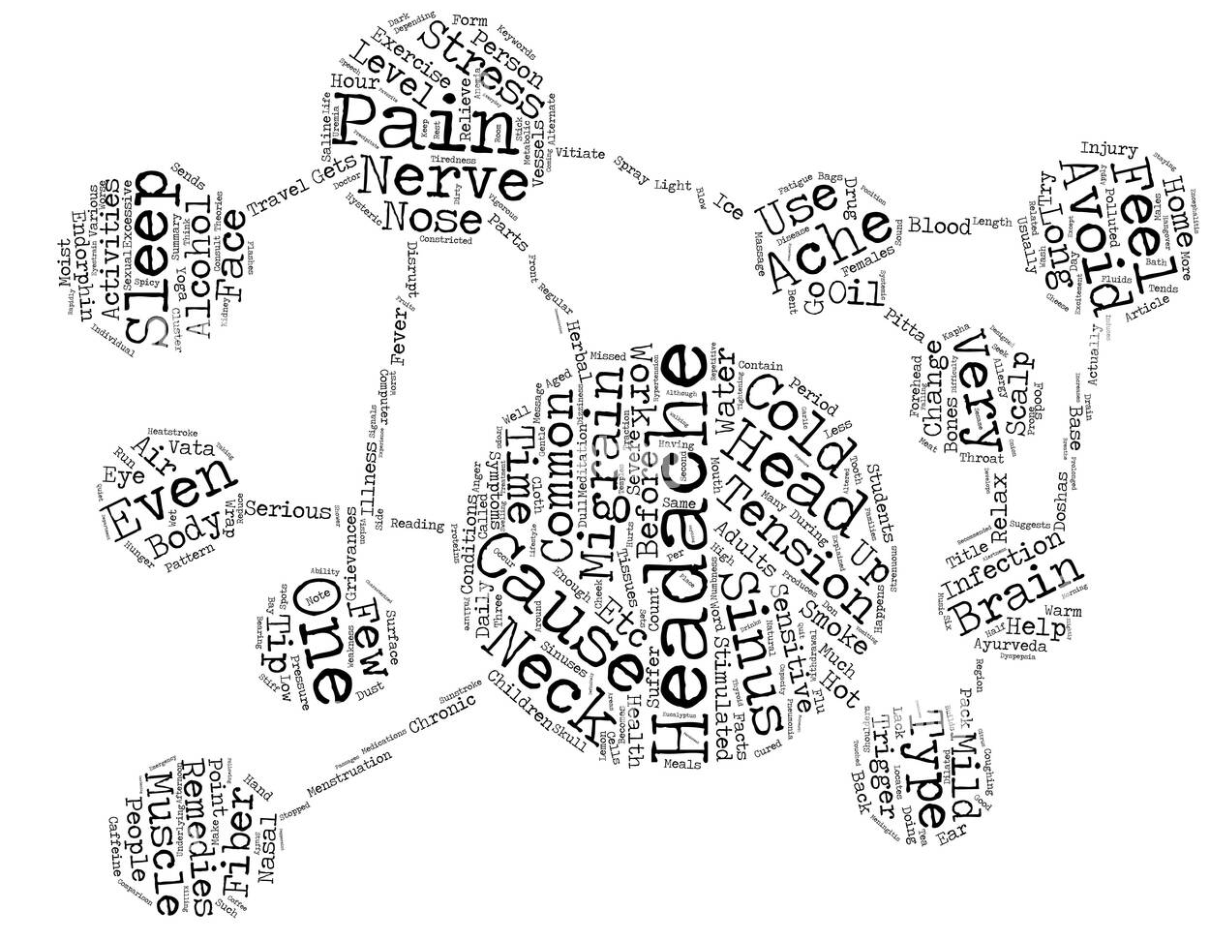

Process in a nutshell
COMPANY DATASET WITH BOTH LABELLED AND UNLABELLED DATA
LABELLED DATA
(SUPERVISED LEARNING)
MULTI-LABEL CLASSIFICATION
Using various ML models
COMPARING MODEL ACCURACIES AND SELECTING THE BEST ONE
UNLABELLED DATA
(UNSUPERVISED LEARNING)
TEXT TOKENIZATION, LEMMATIZATION, VECTORIZATION AND STOP WORD REMOVAL
TOPIC MODELLING BY CLUSTERING THEM INTO TOPICS

Slide 6
Libraries and Algorithms used
NLTK: The basic python natural language processing toolkit.
spaCy: spaCy is an open-source software library for advanced natural language processing. We would need this library to categorize texts into more complicated categories like their grammar or context.
Gensim: Gensim is an open-source library for unsupervised topic modeling and natural language processing, using modern statistical machine learning. We would use this as an addition to spaCy as this is built specifically for topic modelling, esp. for it’s Latent Dirichlet Allocation (LDA) algorithm.
LDA algorithm: LDA was first developed by Blei et al. in 2003. LDA is a generative probabilistic model similar to Naive Bayes. It represents topics as word probabilities and allows for uncovering latent or hidden topics as it clusters the words based on their co-occurrence in a respective document.
Algorithms used in the multilabel classification: Logistic Regression, Stochastic Gradient Descent, Support Vector, K Nearest Neighbour, Decision Tree, Random Forest, Gradient Boosting, Naive Bayes, Xgboost Classifier, LightGBM Classifier, CatBoost Classifier

Slide 7
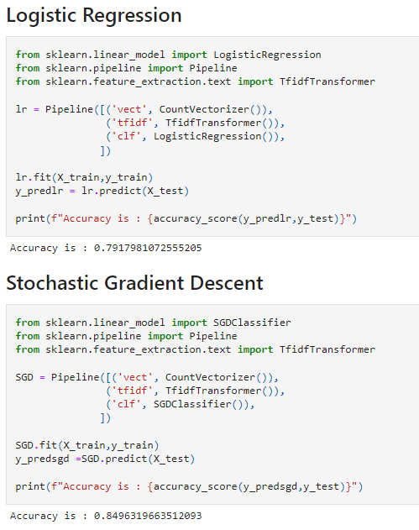
Multi-LABEL classification for the previously labelled dataset
Preprocess the text data by removing stop words and punctuations.
Split the text data (job description) and the label (target variable) into training and testing sets.
Lemmatize the text data.
Transform the text data using Count Vectorizer and TF-IDF transformer (Tfidftransformer will systematically compute word counts using CountVectorizer and then compute the Inverse Document Frequency (IDF) values and only then compute the Tf-idf scores.) using sklearn pipeline.
Run various classification models and compare accuracies.

Slide 8
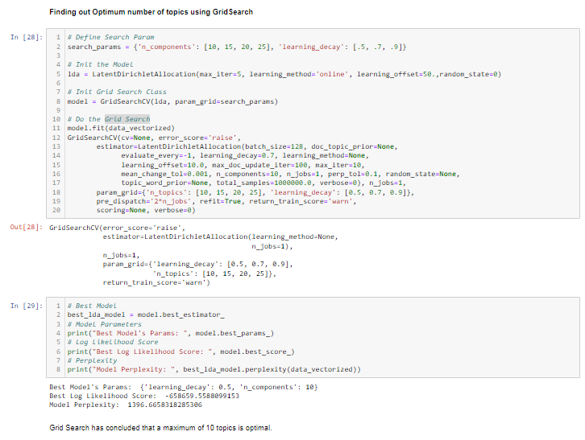
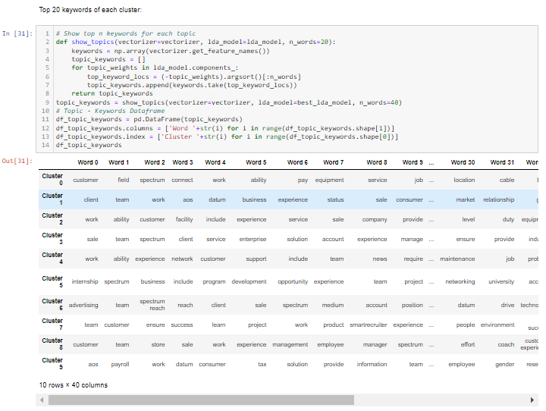
Topic modelling by lda clustering
Preprocess the text data by removing stop words and punctuations.
Lemmatize, Tokenize and Vectorize the text data.
Fit the text data into an LDA model and adjust it’s parameters for an initial run.
Find out the optimum number of clusters and learning decay using Grid Search.
Tune the LDA model accordingly and run it.
Label each text entry by it’s dominant cluster number.
Read the cluster words and label the clusters.

Slide 9

Results
Let’s Dive In

Slide 10
ACCURACIES BY MODELS
MODEL | ACCURACY
Logistic Regression | 79.17%
Stochastic Gradient Descent | 84.96%
Support Vector | 81.80%
K Nearest Neighbour | 77.07%
Decision Tree | 77.91%
Random Forest | 81.38%
Gradient Boosting | 82.96%
Naive Bayes | 63.40%
Xgboost Classifier | 84.96%
LightGBM Classifier | 85.48%
CatBoost Classifier | 82.75%
The LightGBM classifier accuracy is 10% more than the current company accuracy.

Slide 11
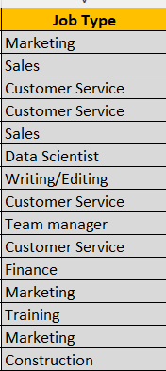
Clustering results
Using Grid Search, we found out that the optimum number of clusters is 10. The following are the top 6 words in each cluster.
 | Word 0 | Word 1 | Word 2 | Word 3 | Word 4 | Word 5
Cluster 0 | customer | field | spectrum | connect | work | ability
Cluster 1 | client | team | work | aos | datum | business
Cluster 2 | work | ability | customer | facility | include | experience
Cluster 3 | sale | team | spectrum | client | service | enterprise
Cluster 4 | work | ability | experience | network | customer | support
Cluster 5 | internship | spectrum | business | include | program | development
Cluster 6 | advertising | team | spectrum reach | reach | client | sale
Cluster 7 | team | customer | ensure | success | learn | project
Cluster 8 | customer | team | store | sale | work | experience
Cluster 9 | aos | payroll | work | datum | consumer | tax
*************************

Slide 12

What’s next
LOOKING AHEAD

Slide 13
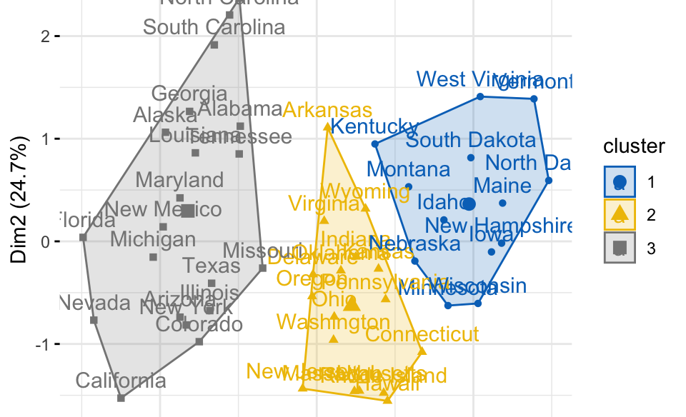
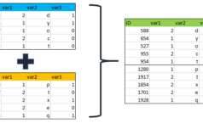
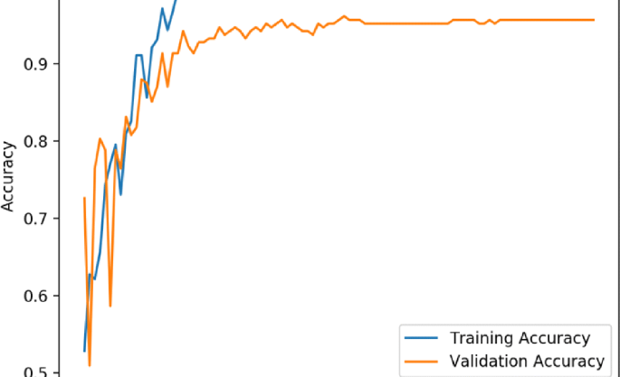
Final steps
TUNE CLUSTERS
Adjusting the learning rate in the grid search to find the most meaningful group of words for proper clustering.
MERGE THE 2 DATASETS
Merge the previously and newly labelled dataset.
EVALUATE THE FINAL DATASET ACCURACY
After merging the final dataset, the accuracies would be evaluated similar to the pre-labelled dataset.

Slide 14

THANK YOU

